Slide 1
Exception Handling

Slide 2
In Java, Exception is an unwanted or unexpected event, which occurs during the execution of a program, i.e. at run time, that disturbs the normal flow of the program’s instructions.
Exceptions can be caught and handled by the program. When an exception occurs within a method, it creates an object.
This object is called the exception object.
It contains information about the exception, such as the name and description of the exception and the state of the program when the exception occurred.

Slide 3
Major reasons why an exception Occurs
Invalid user input
Device failure
Loss of network connection
Physical limitations (out-of-disk memory)
Code errors
Opening an unavailable file

Slide 4
Exception Handling in Java is one of the effective means to handle runtime errors so that the regular flow of the application can be preserved.
Java Exception Handling is a mechanism to handle runtime errors such as ClassNotFoundException, IOException, SQLException, RemoteException, etc.

Slide 5
Exception handling does not repair exceptions, but it find alternate way,

Slide 6
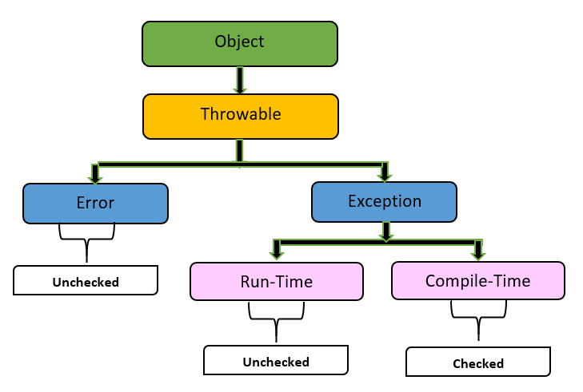
Exception Hierarchy

Slide 7
Difference bet Exception and Error
Exception occur due to our program.
Error occur due to lack of system resources.
Example of error-out of memory error

Slide 8
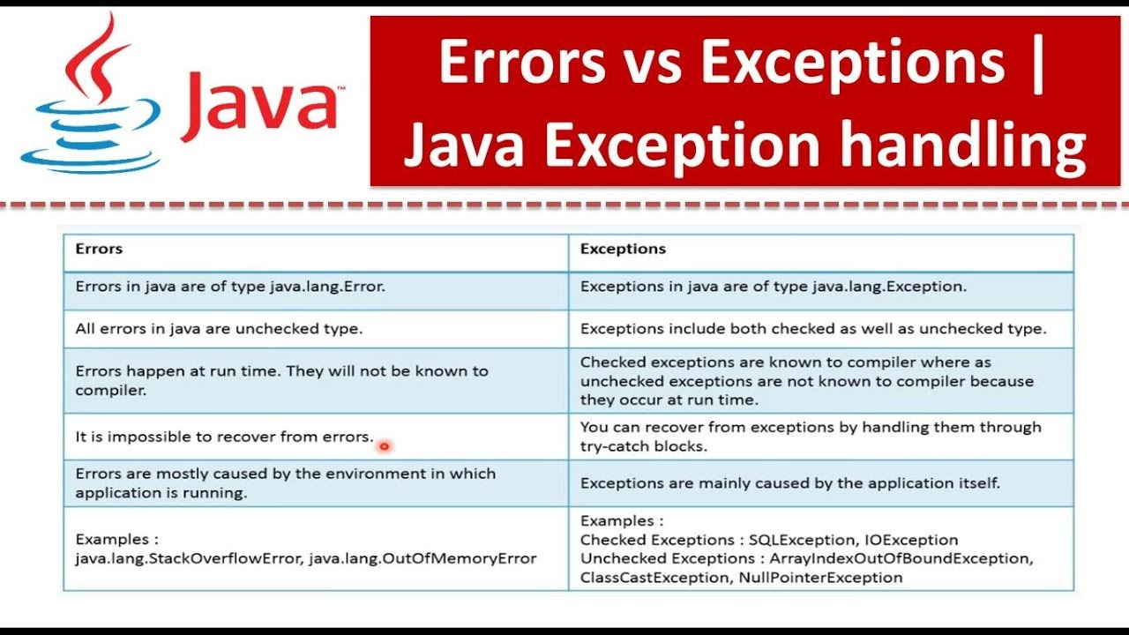

Slide 9
All classes in Java, directly or indirectly, inherit from the "Object" class. The "Object" class provides a set of methods and functionalities that are common to all Java objects.

Slide 10
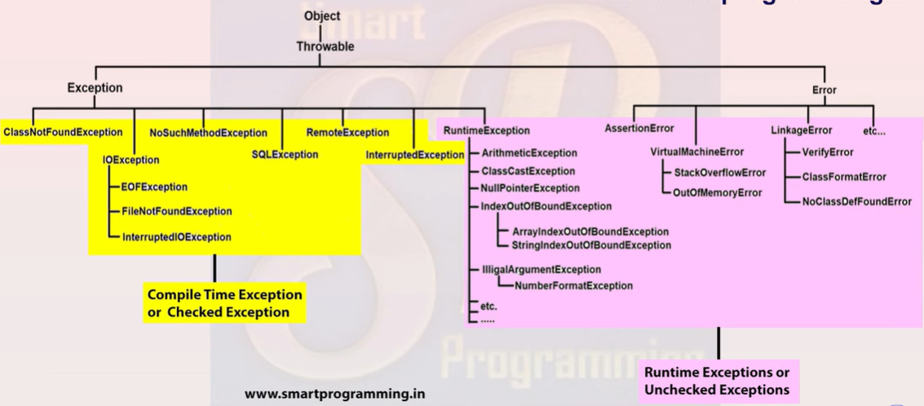

Slide 11
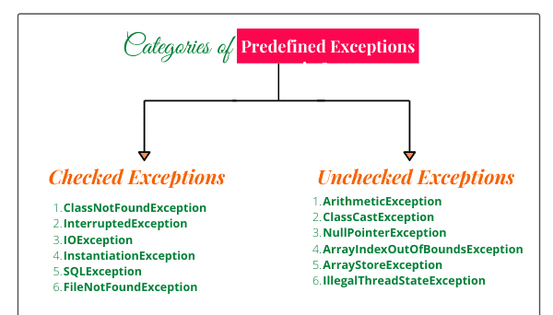
Unchecked and checked exception(run time and compile time)

Slide 12
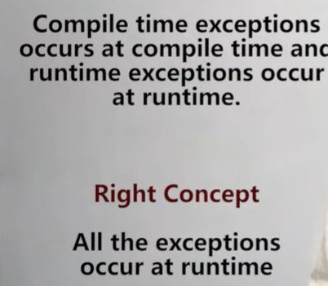
Checked exception(compile time) unchecked exception(runtime)
No any exception occur at compile time

Slide 13
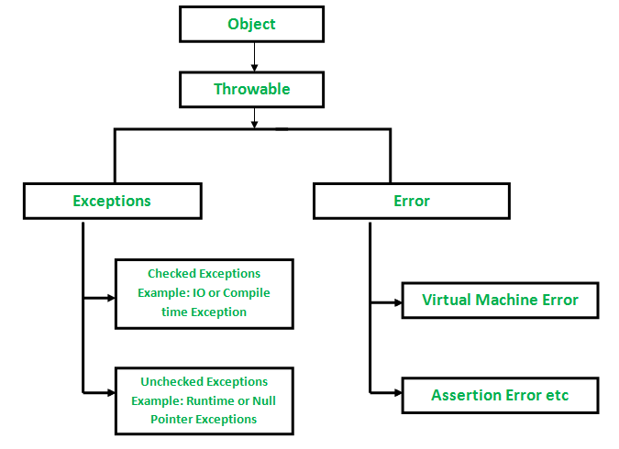

Slide 14
Compile time exception –can be checked by compiler.
Compiler ignores-run time exception.(OR CAN’T PREDICT)
E.g-you are going for exam:
Step 1-mother ask for idcard is taken or not
Step-2-mother ask for pen
Step-3-mother ask for water bottle, bike keys
Step-4-while driving-puncture. Or oil finishes inside bike
Step-5-id card is not with u.

Slide 15
Checked Exceptions in Java
These are the exceptions that are checked at compile time. If some code within a method throws a checked exception, then the method must either handle the exception or it must specify the exception using the throws keyword.
In checked exceptions, there are two types: fully checked and partially checked exceptions. A fully checked exception is a checked exception where all its child classes are also checked, like IOException, and InterruptedException. A partially checked exception is a checked exception where some of its child classes are unchecked, like an Exception.

Slide 16
Unchecked Exceptions in Java
These are the exceptions that are not checked at compile time. In C++, all exceptions are unchecked, so it is not forced by the compiler’s to either handle or specify the exception.
It is up to the programmers to be civilized and specify or catch the exceptions.
In Java, exceptions under Error and RuntimeException classes are unchecked exceptions, everything else under throwable is checked.

Slide 17
Try-catch
Whenever there is exception occurs , the method in which exception occurs will create object and that object will store 3 things:
1)Exception class name
2)description
3)stack trace(line no)

Slide 18
Exception flow
JVM
The method in which exception occurs will create one object
Exception occurs
Manually handle(by using try ,catch,….)
If not handled by us, default exception handler will handle but firstly program will abnormally terminate

Slide 19
Exception handling
Try- risky code
Catch-handling code
Finally
Throw
Throws

Slide 20
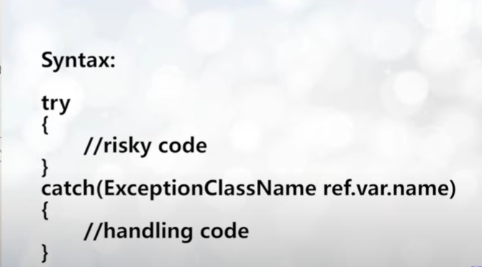

Slide 21
Flow of execution
Try-if exception doesn’t occur then catch block will not execute.

Slide 22
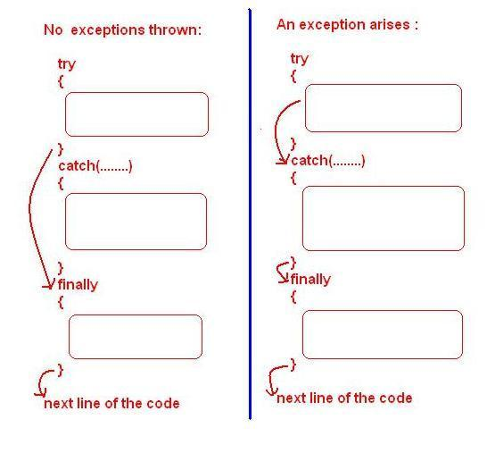
Finally block
Finally block will always execute whether exception is handled or not.

Slide 23
Why finally block?
Finally block contains clean-up code
To close connection-e.g database connection, file close code, memory release code,lock close code
Resources open in try block---closes in finally block

Slide 24



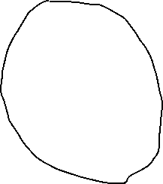

JVM
Main()
{
method();
}
Method()
{
exception occur
}
Default Exception
handler
1)Exception class name
2)description
3)stack trace(line no)

Slide 25
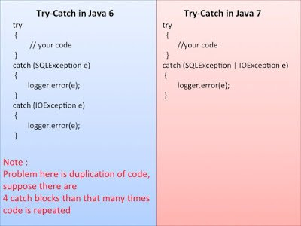
Multiple catch block

Slide 26
Throw keyword
Used inside method.
The Java throw keyword is used to throw an exception explicitly.
We specify the exception object which is to be thrown. The Exception has some message with it that provides the error description.

Slide 27
throws

